Slide 1
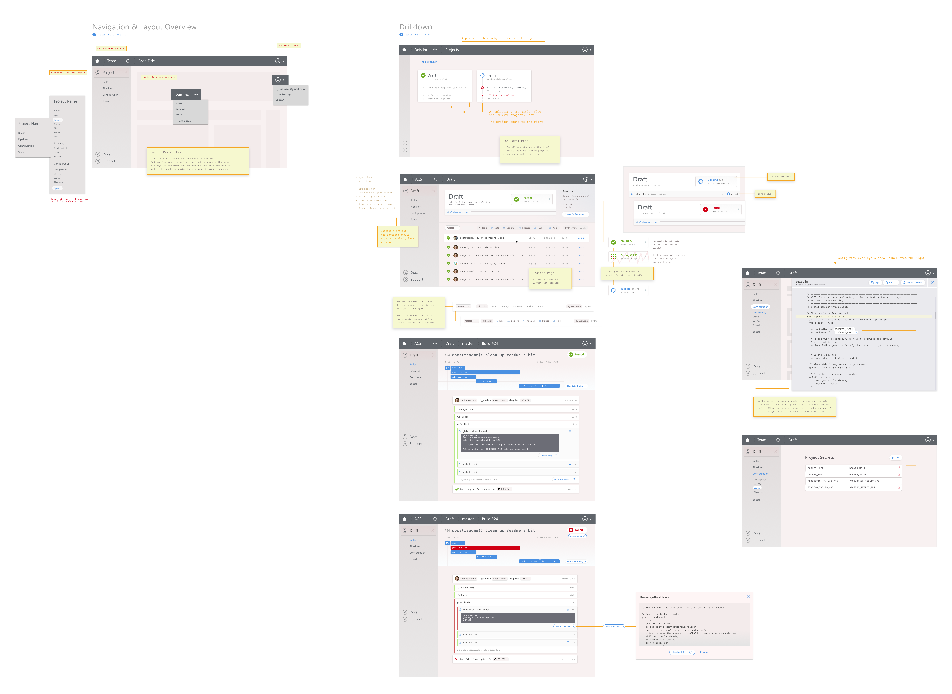
“ACICD Project” UI Wireframes
Visit this URL to view all the Wireframes.

Slide 2
UI Flow, screen-by-screen
I.A:
- Dashboard (see projects)
|- Projects |-|- Builds
|-|-|- Jobs
|-|-|-|- Tasks
I.A:
- Dashboard (see projects)
|- Projects |-|- Builds
|-|-|- Jobs
|-|-|-|- Tasks

Slide 3
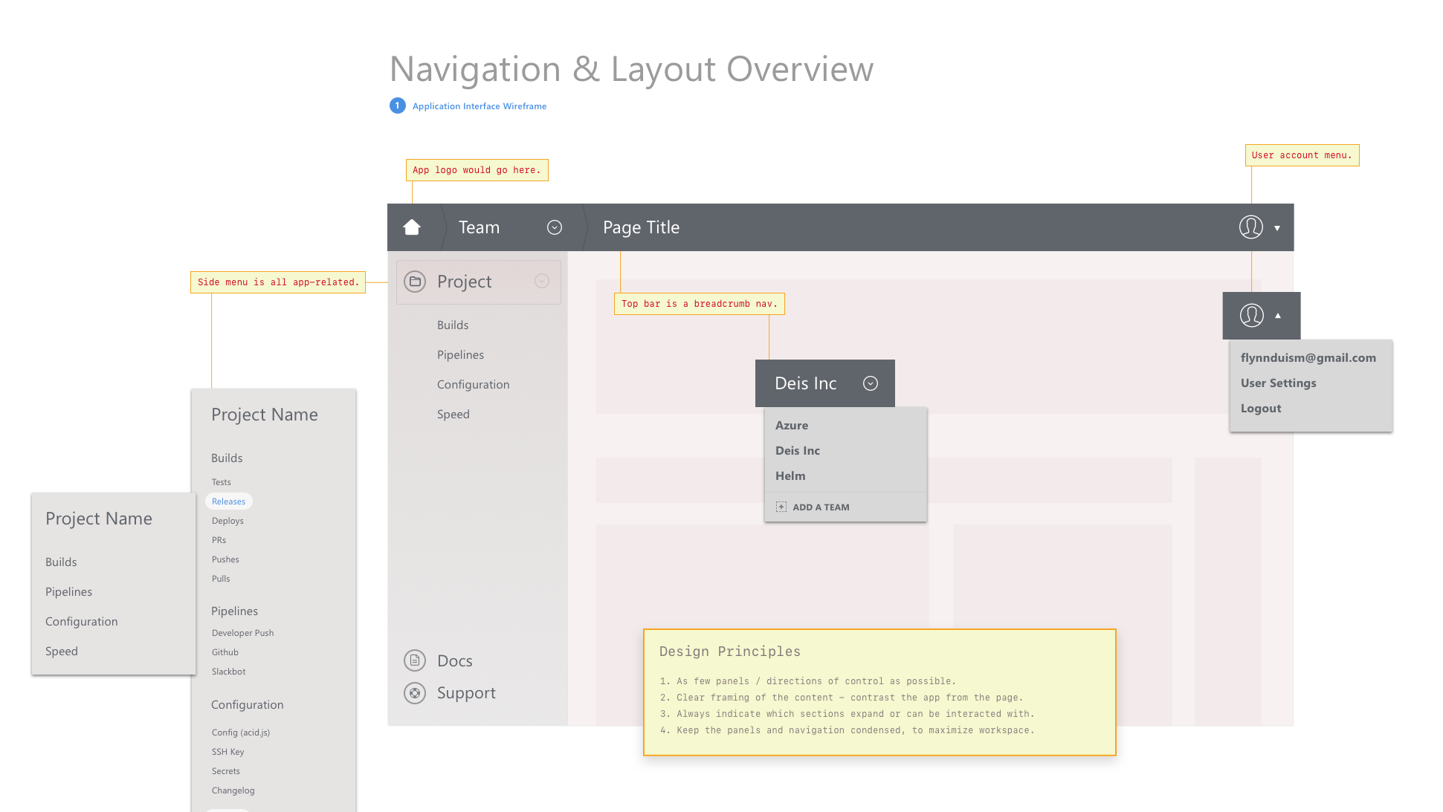

Slide 4
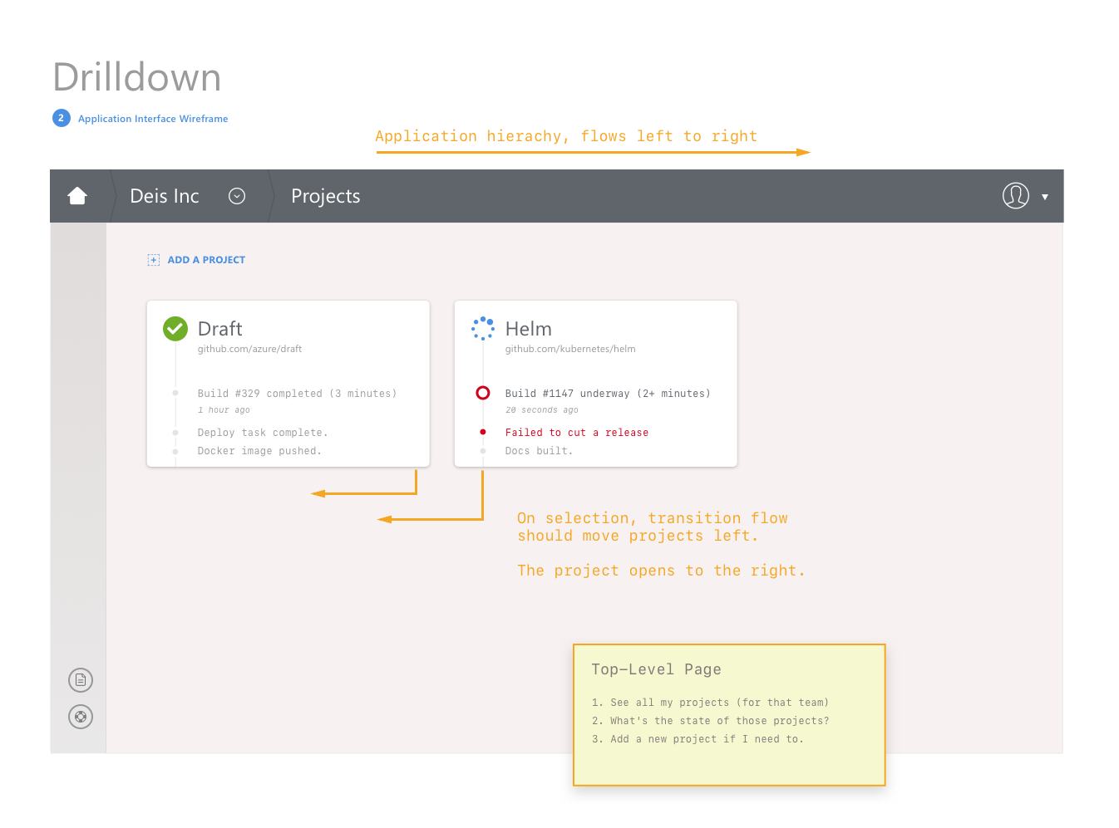

Slide 5
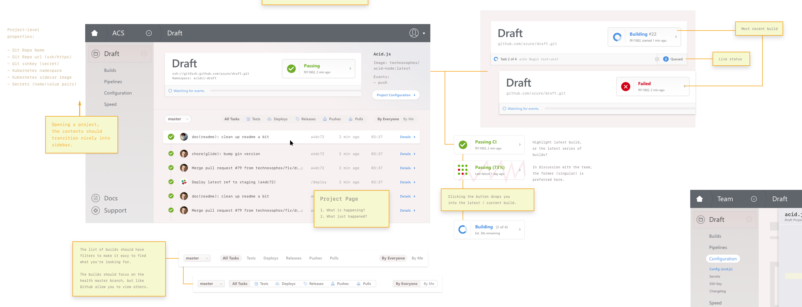

Slide 6
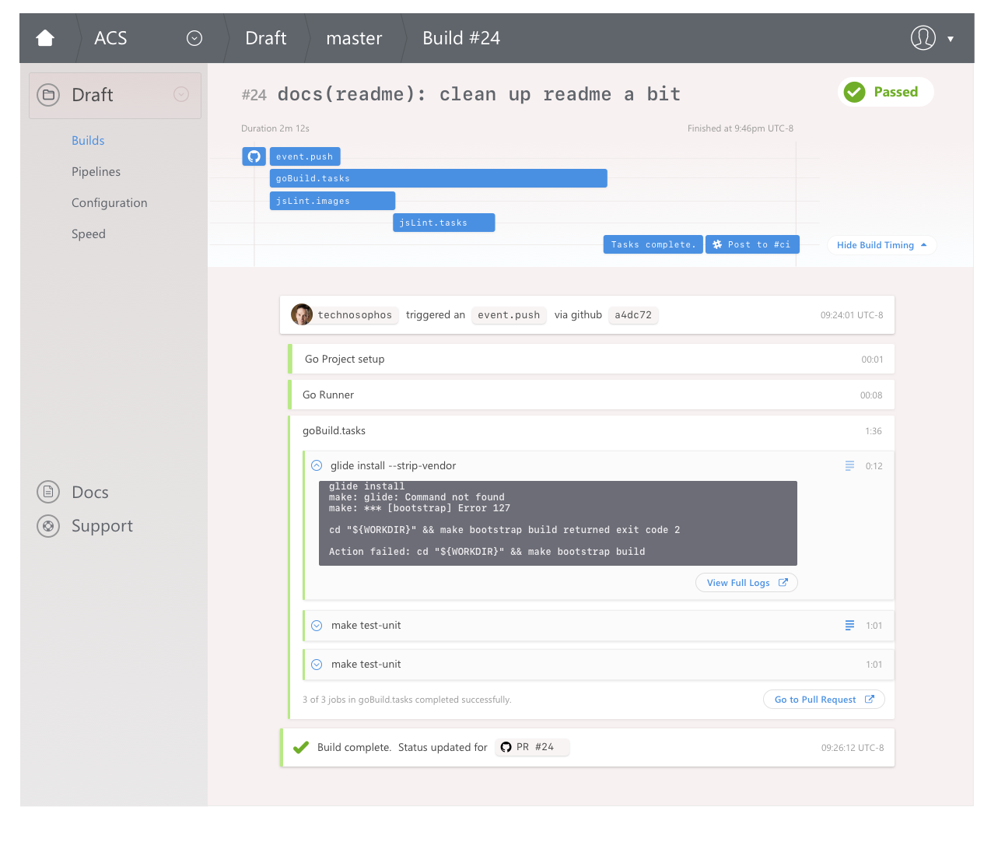

Slide 7
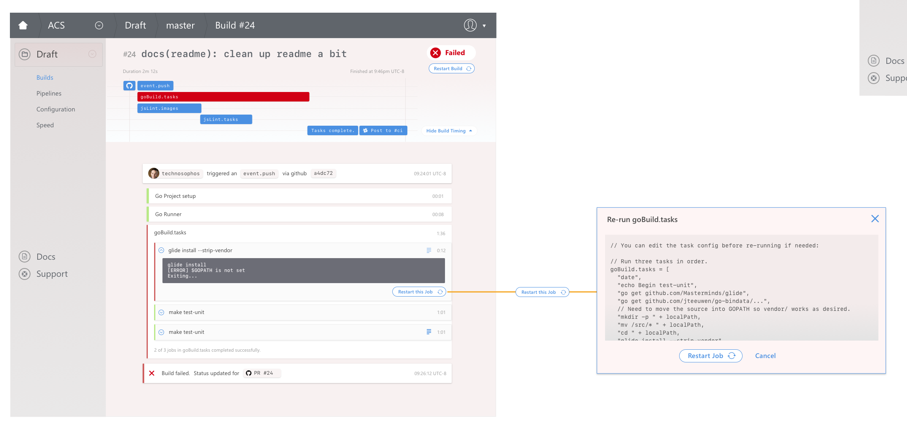

Slide 8
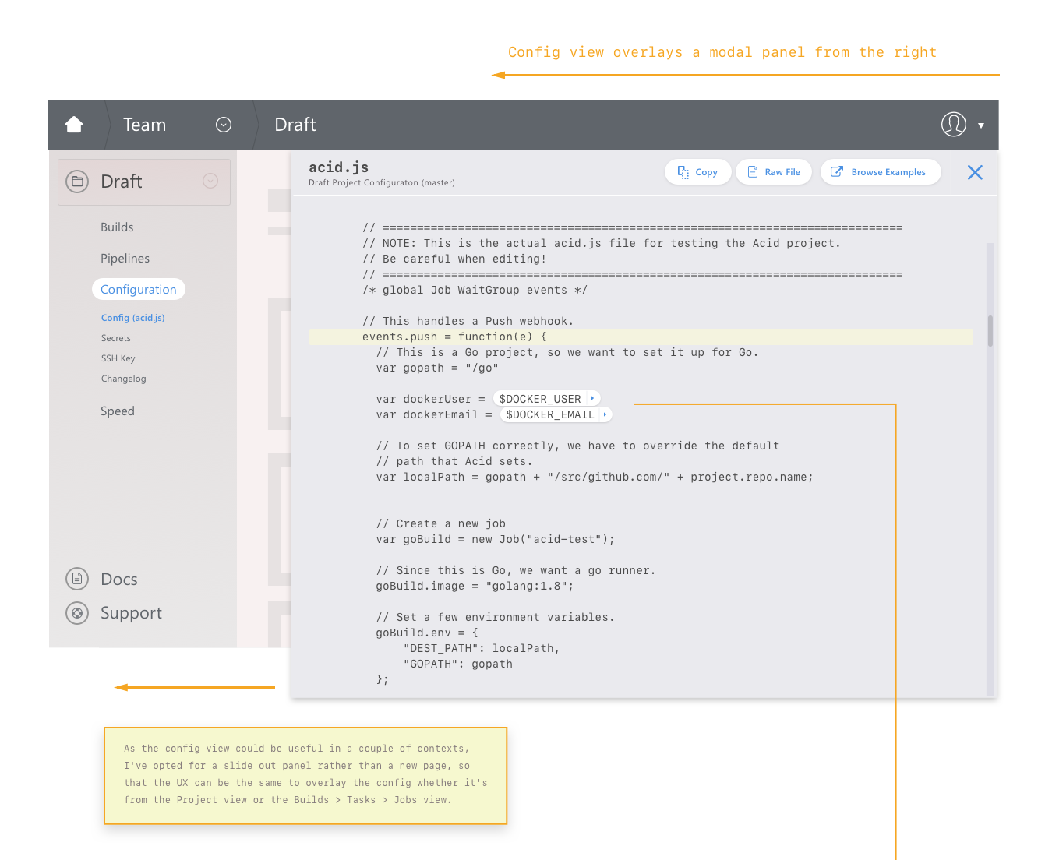

Slide 9
